Slide 1
CPCU Chapter Europe Meeting
Exploring Ethics
Cheryl R. Constantine, CPCU, ASLI, AIS

Slide 2
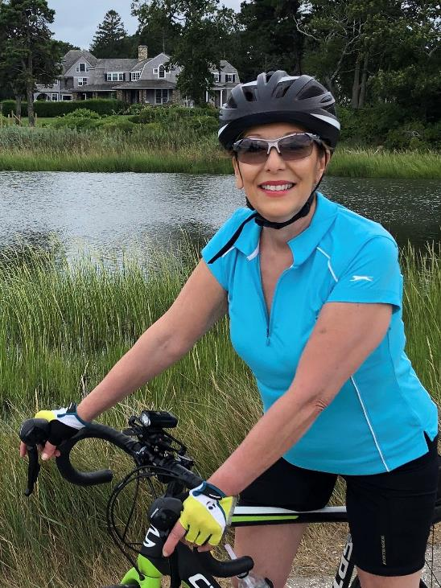
Cheryl R. Constantine, CPCU, ASLI, AIS
Director, BI Talent Development & Learning
10 years Agent & Broker - Aon Risk Services
12 years Multi-Line Underwriting – Travelers & IFG Companies
14 years Travelers Business Insurance Talent Development & Learning
UPDP Program Manager
Line of Business Training Instructor
Member CT & Europe CPCU Chapters
Past President – CT CPCU Chapter
Past CPCU Diversity Equity & Inclusion Chair
CT Justice of the Peace
Osterville, Cape Cod MA

Slide 3
Important Note
The opinions expressed in this webinar are those of the authors and do not necessarily reflect those of the author’s employers, or clients.
The content of this presentation is only for the informational use of the reader. Information contained herein is not intended as, nor does it constitute, legal or professional advice, nor is it an endorsement of any source cited or information provided. In no event will Travelers or any of its subsidiaries and affiliates be liable in contract or in tort to anyone who has access to this presentation for the accuracy or completeness of the information relied upon in the preparation of this presentation or for the completeness of any recommendations from cited sources. This presentation does not amend, or otherwise affect, the provisions or coverages of any insurance policy or bond issued by Travelers, nor is it a representation that coverage does or does not exist for any particular claim or loss under such policy or bond. Coverage depends on the facts and circumstances involved in the claim or loss, all applicable policy or bond provisions, and any applicable law.

Slide 4
Discussion Topics
Main Approaches to Ethical Decision Making
Common Myths about Business Ethics
CPCU Chapter Inclusion, Diversity, Equity and Awareness

Slide 5
Main Approaches to Ethics
People’s Belief Systems

Slide 6
Main Approaches to Ethics
Let’s start with a question?
What is your approach in making ethical decisions?
Provide a few descriptive words that would describe your value system.

Slide 7
Virtue Ethics Approach
Good behavior is the route to individual self-fulfillment.
Doing the right thing makes you a better person

Slide 8
Utilitarian Approach
Not concerned with the specific actions
Focused on the results of those actions
Greatest good for the greatest number of people

Slide 9
Deontology Approach
What’s right is right
The rules are the rules
Sense of Duty

Slide 10
Common Myths about Business Ethics
Ethics are a matter of personal opinion.
Religion is the only good guide to ethics.
Obeying the law is enough to ensure that your behavior is ethical.
You can separate personal and professional ethics.
You are either ethical or not.

Slide 11
Chapter COE D&I Initiatives
Chapters have made significant progress in pursuing D&I initiatives
16 Chapters have formal D&I Chairs
Chapter activities include D&I speakers, panel presentations, networking events, recruiting initiatives, career explorations events
Notes:
117 Chapters which includes Europe and Japan
2017 32
2018 65
2019 85
16 Chapters have formal D&I Chairs and committees
Don’t have the 2020 data yet but would not be surprised if we are close to 100%.

Slide 12
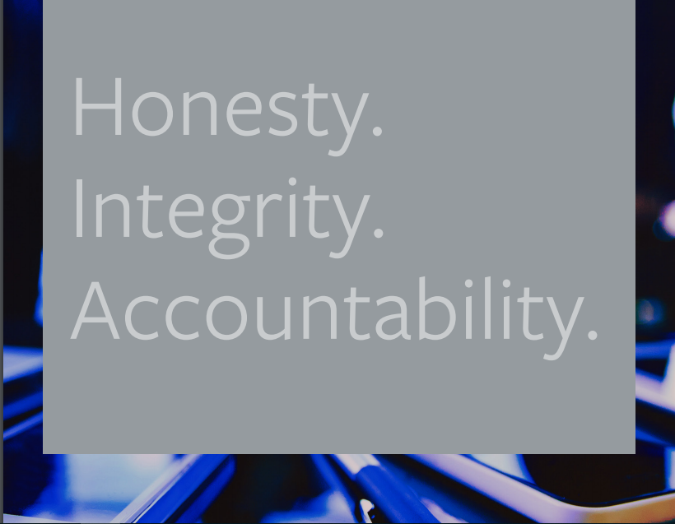
Our Most Valuable Asset!
“First, our reputation is our most valuable asset, and each of us has a role to play in protecting our good name. No gain is worth sacrificing our reputation.”
“Second, we can never let our drive to deliver industry-leading results cloud our ethical judgment. No outcome is worth unethical behavior.”
“Third, the only long-term, sustainable success in business is achieved in partnership with our employees, agents, brokers and customers – never at their expense.”
“Fourth, we have the skill and creativity to solve any problem and meet any challenge. But we can only solve problems and meet challenges if we’re honest with ourselves and each other about what those problems and challenges are.”

Slide 13
Boeing 737 Max

